Slide 1
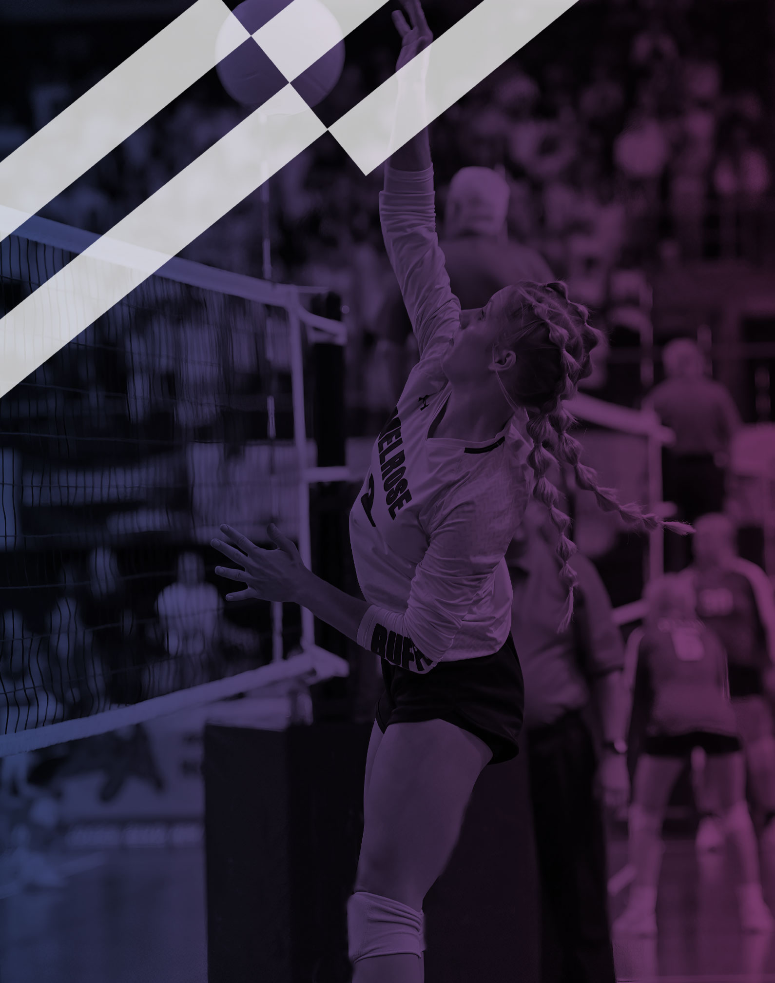
2026-27 NFHS Volleyball Rules PowerPoint
Rules Changes
Editorial Changes
Points of Emphasis

Slide 2
2026 NFHS Volleyball
Rules Changes

Slide 3
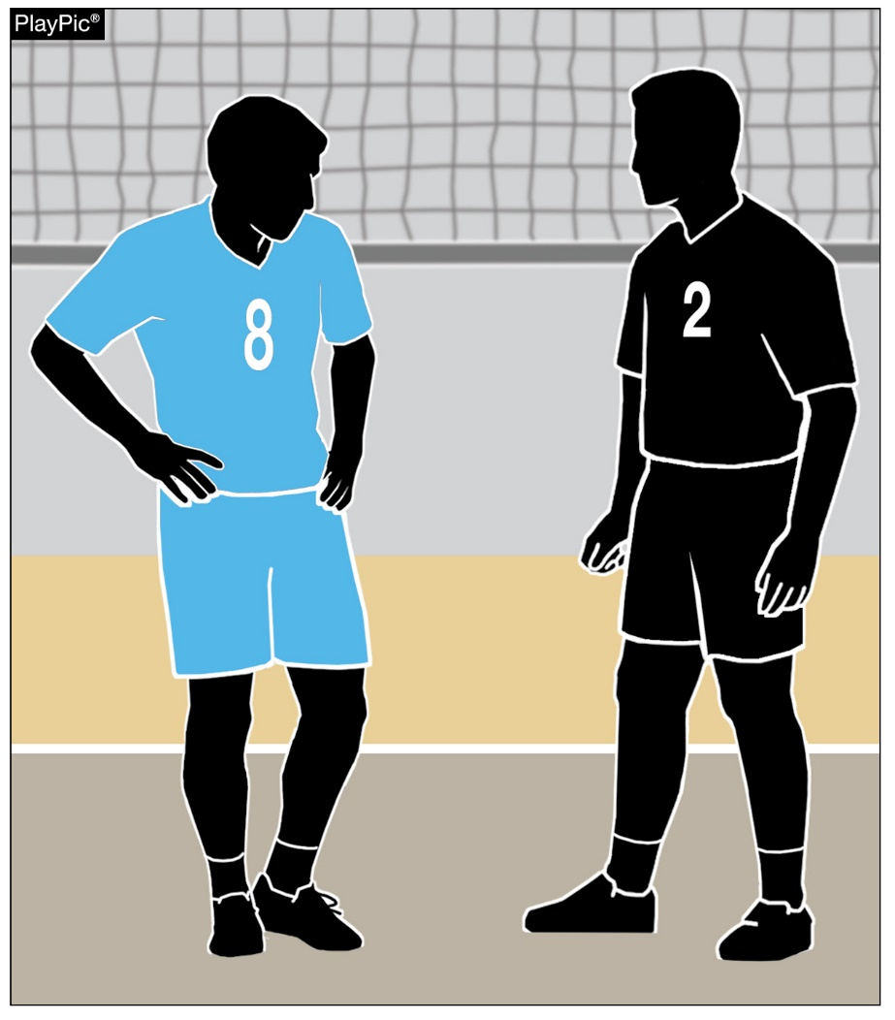
LEGAL UNIFORM
4-2-1a, 4-2-1i(3) (NEW), 4-2-2
Libero uniform bottoms may be any color and are no longer required to match the team uniform bottoms.
When two liberos are designated, there is no requirement that both liberos wear the same color uniform bottom.
Notes:
Libero uniform bottoms may be any color and are no longer required to match the team uniform bottoms.
When two liberos are designated, there is no requirement that both liberos wear the same color uniform bottom.
Rationale: Allows more flexibility in the libero uniform bottoms while ensuring that the libero uniform top continues to contrast with their teammates.

Slide 4
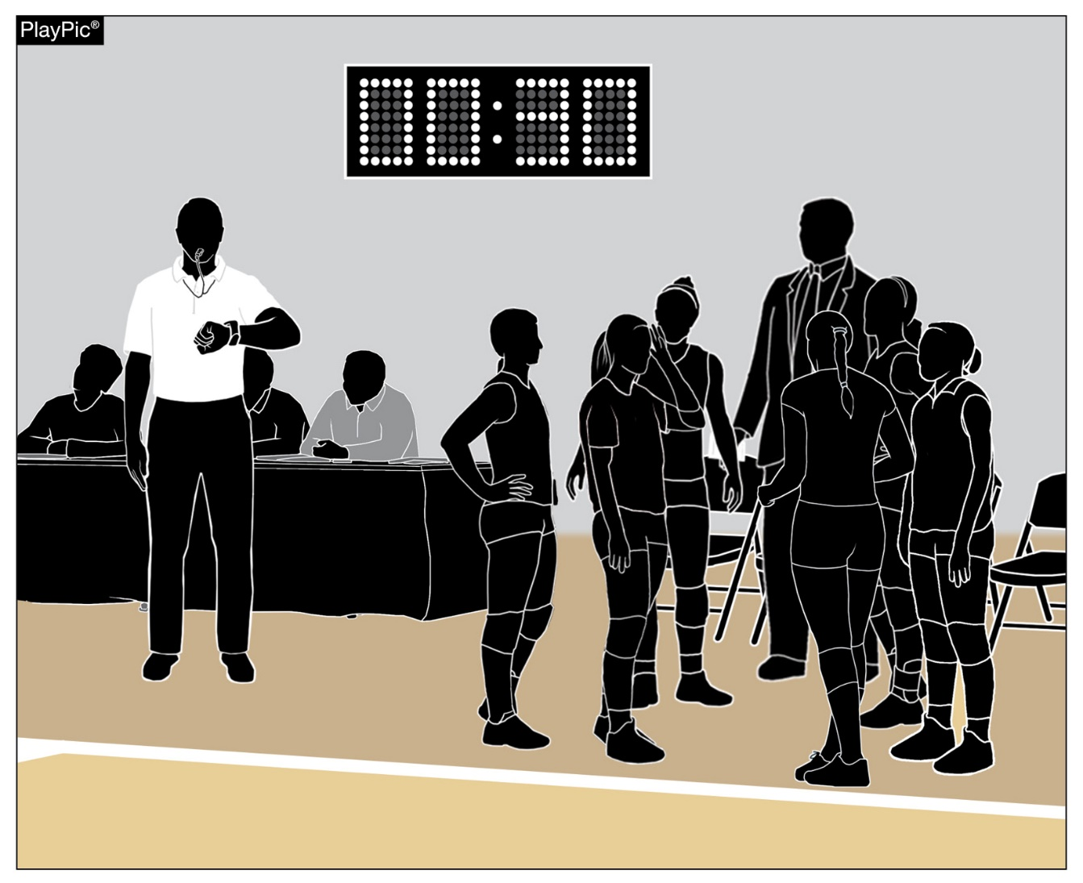
SECOND REFEREE RESPONSIBILITIES
5-5-3b(21)
Between sets, the second referee will provide a double whistle warning at two minutes, 30 seconds instead of 2 minutes, 45 seconds.
Teams should be on the court ready to play when the horn sounds at the end of the 3 minutes.
Notes:
Between sets, the second referee will provide a double whistle warning at two minutes, 30 seconds (4:30 when intermission is used) instead of 2 minutes, 45 seconds.
Rationale: Improves pace of play between sets by notifying teams earlier to make their way onto the court for the officials to administer lineup checks before the final audio signal and resumption of play.

Slide 5
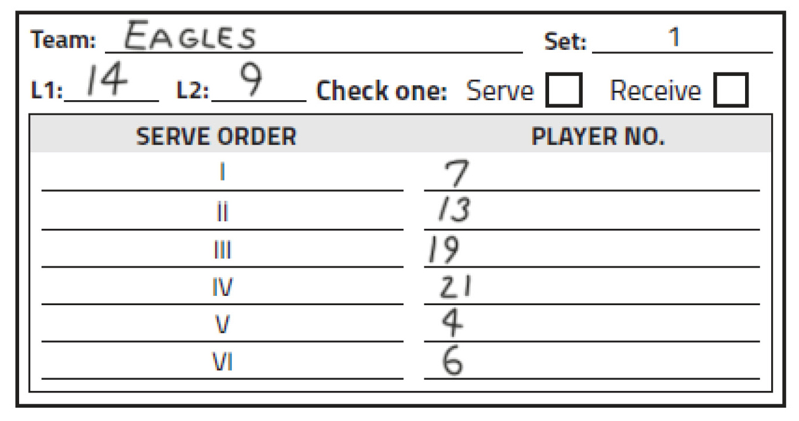
PLAYER POSITIONS
5-7-3c, 5-7-3d, 6-4-2, 8-1-6, 9-8-2, 10-3-6c, 10-4, 11-4-1b
A team may designate up to two liberos, but only one libero can be in the game at a time.
When two liberos are designated, either libero may serve in one position in the serve order.
If the L1 and L2 serve, they must serve in the same position throughout the set.
Notes:
A team may designate up to two liberos, but only one libero can be in the game at a time.
When two liberos are designated, either libero may serve in one position in the serve order. If the L1 and L2 serve, they must serve in the same position throughout the set.

Slide 6
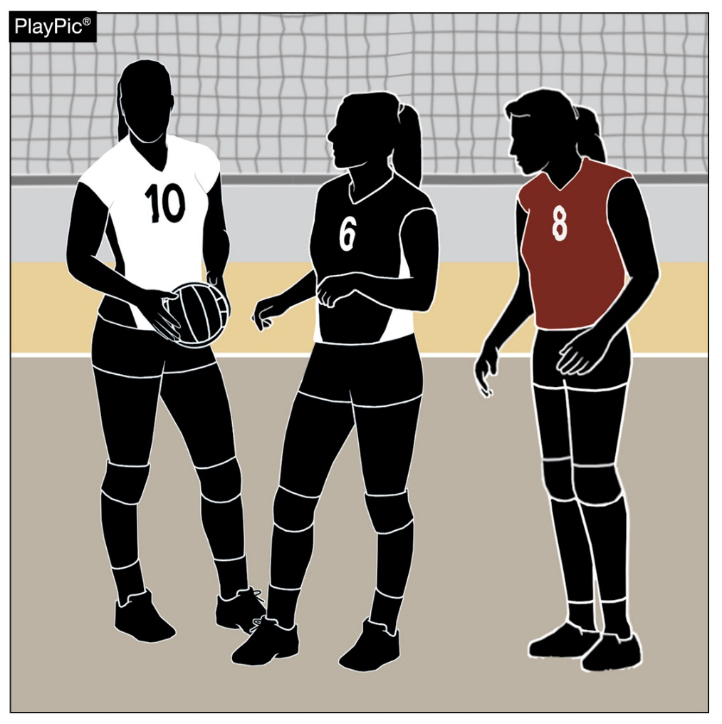
PLAYER POSITIONS
5-7-3c, 5-7-3d, 6-4-2, 8-1-6, 9-8-2, 10-3-6c, 10-4, 11-4-1b
Each libero may wear a different uniform, as long as that uniform clearly contrasts from non-libero teammates.
A libero may not wear a number that a non-libero teammate is wearing, and each libero uniform must be a different, unique number.
Notes:
Each libero may wear a different uniform, as long as that uniform clearly contrasts from non-libero teammates.
A libero may not wear a number that a non-libero teammate is wearing, and each libero uniform must be a different, unique number.

Slide 7
PLAYER POSITIONS
5-7-3c, 5-7-3d, 6-4-2, 8-1-6, 9-8-2, 10-3-6c, 10-4, 11-4-1b
When a team designates two liberos and one is injured/ill, a new libero may be re-designated.
When a team designates two liberos and one is disqualified; the team must continue with one libero.
Notes:
When a team designates two liberos and one is injured/ill, a new libero may be re-designated.
When a team designates two liberos and one is disqualified; the team must continue with one libero.
Rationale: The change to allow for up to two liberos, provides more student-athletes with an opportunity to participate by creating an option for coaches without having to utilize a substitution.

Slide 8
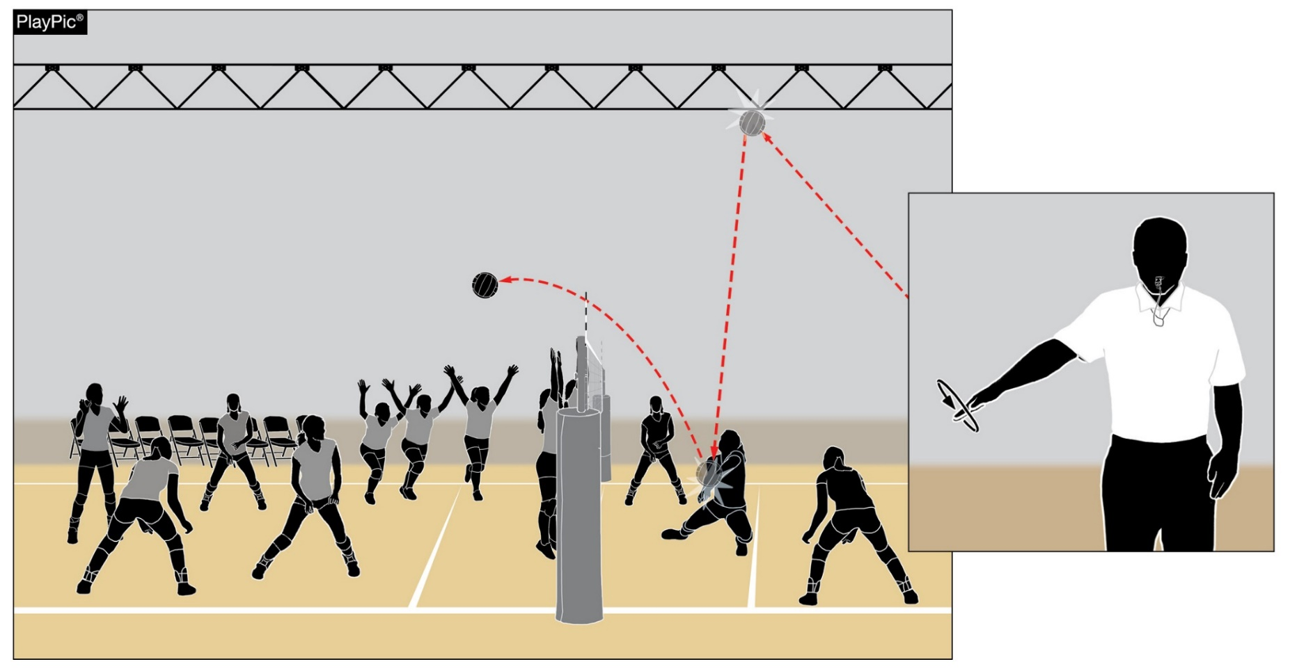
PLAYER POSITIONS
6-4 PENALTIES 1c (NEW), 12-2-8b NOTE (NEW)
If non-playing teammate(s) (bench players) enter the court during play, it is illegal alignment.
A loss of rally/point is awarded to the opponent.
Notes:
If non-playing teammate(s) (bench players) enter the court during play, it is illegal alignment.
A loss of rally/point is awarded to the opponent.
Rationale: More appropriately assesses illegal alignment (loss of rally/point awarded to the opponent) to non-playing teammates who enter the court while the ball is in play. A player who enters the court during play may still receive a conduct violation if they engage in disconcerting acts, disrespectful language, etc. This penalty realignment allows officials to appropriately penalize teams based on participant actions.

Slide 9
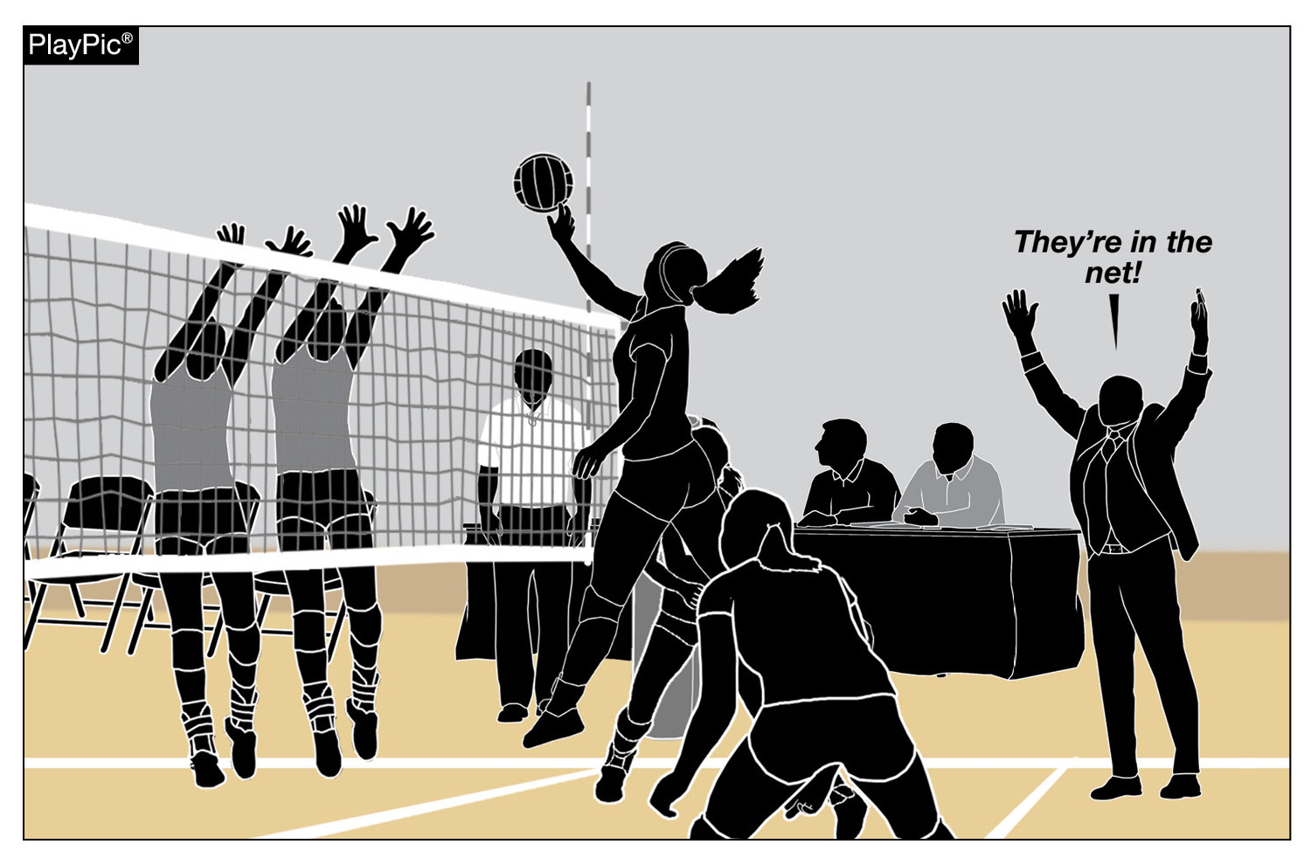
PLAYER POSITIONS
6-4 PENALTIES 1c (NEW), 12-2-8b NOTE (NEW)
It remains a conduct violation if
  a coach or team attendant (anyone not in uniform) enters the court while the ball is in play.
Notes:
It remains a conduct violation if a coach or team attendant (anyone not in uniform) enters the court while the ball is in play.

Slide 10
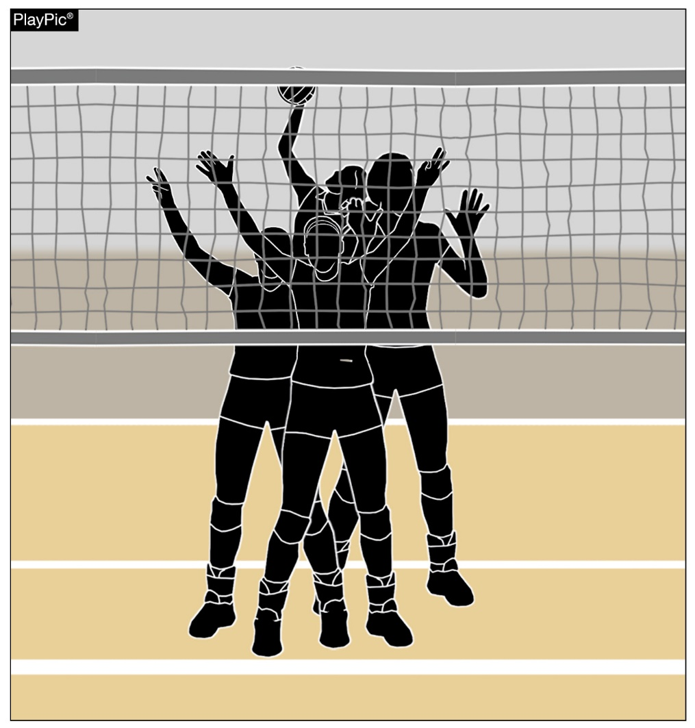
SCREENING 6-5-1
Players on the serving team are not permitted to raise their hands above their heads during service until the ball has passed beyond the net.
Players may quickly raise their hands above their heads to give hand signals and then lower their arms immediately.
Players may also stand with their hands locked together behind their heads to protect the back of their heads during service.
Notes:
Players on the serving team are not permitted to raise their hands above their heads during service until the ball has passed beyond the net.
Players may quickly raise their hands above their heads to give hand signals and then lower their arms immediately.
Players may also stand with their hands locked together behind their heads to protect the back of their heads during service.
Rationale: Discourages player positioning during the serve that prevents the receiving team from viewing service contact and/or the flight of the ball and assists officials when evaluating the existence of screening. This change aligns with all other volleyball rules codes.

Slide 11
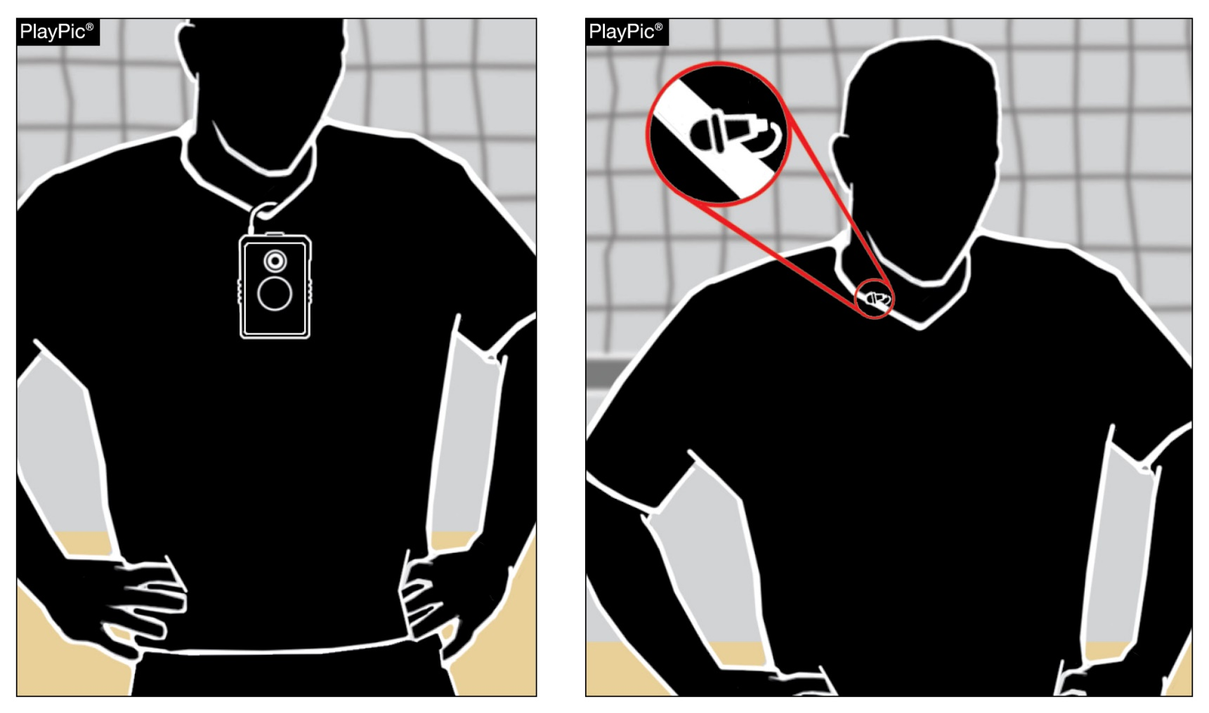
COURT PROTOCOL
9-2-1 NOTE 1 (NEW)
Players shall not wear any audio or video devices during the match.
If referees notice devices on players prior to the match, they should notify the coach to direct the player to remove the device.
If discovered during play, the player should be assessed an unsporting conduct penalty.
Notes:
Players shall not wear any audio or video devices during the match.
If referees notice devices on players prior to the match, they should notify the coach to direct the player to remove the device.
If discovered during play, the player should be assessed an unsporting conduct penalty.
Rationale: Clarifies the prohibition of electronic communication with and by players during the match and aligns with other NFHS rules codes.

Slide 12
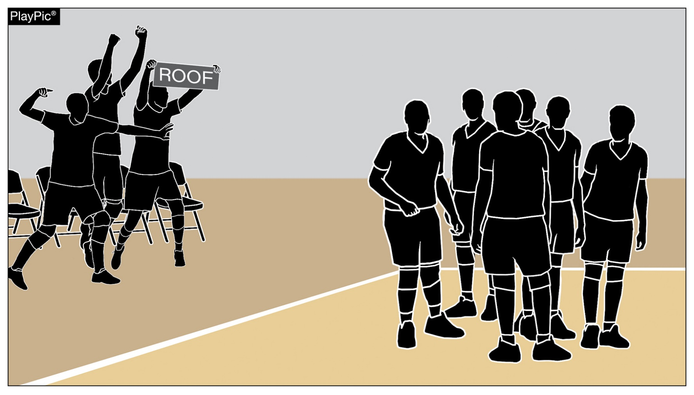
CONDUCT: PLAYERS, COACHES AND/OR TEAM ATTENDENT
12-2-8m (NEW)
It is an unsporting conduct violation if coaches, non-playing teammates or team attendants use props on the bench during celebrations.
Notes:
It is an unsporting conduct violation if coaches, non-playing teammates or team attendants use props on the bench during celebrations.
Rationale: Clarifies appropriate bench conduct for consistent enforcement by eliminating the use of props in bench celebrations while promoting sportsmanship and preventing disruption and potential safety concerns.

Slide 13
2026 NFHS Volleyball
Points of Emphasis

Slide 14
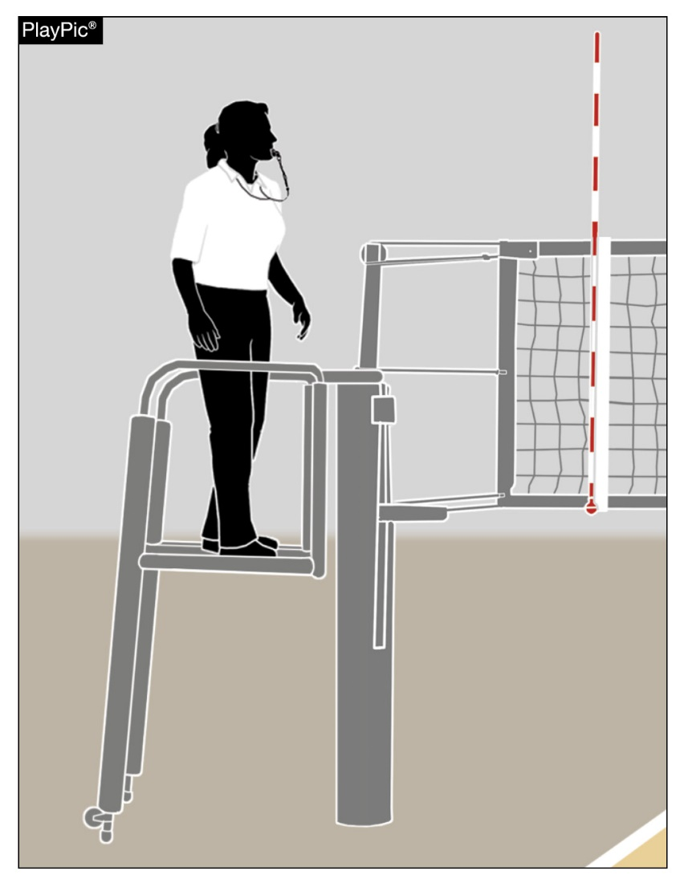
HOST MANAGEMENT BEST PRACTICES
By rule, hosts must provide a safe, stable platform. The first referee (R1) should carefully examine the stand prior to the match, and if the R1 determines that the platform is unsafe, the match will still go on, and the R1 will work from the floor.
Referees should not use ladders, chairs, boxes, trash cans or similar substitutes that could endanger the well-being of the official.
Notes:
By rule, hosts must provide a safe, stable platform. The first referee (R1) should carefully examine the stand prior to the match, and if the R1 determines that the platform is unsafe, the match will still go on, and the R1 will work from the floor.
Referees should not use ladders, chairs, boxes, trash cans or similar substitutes that could endanger the well-being of the official.

Slide 15
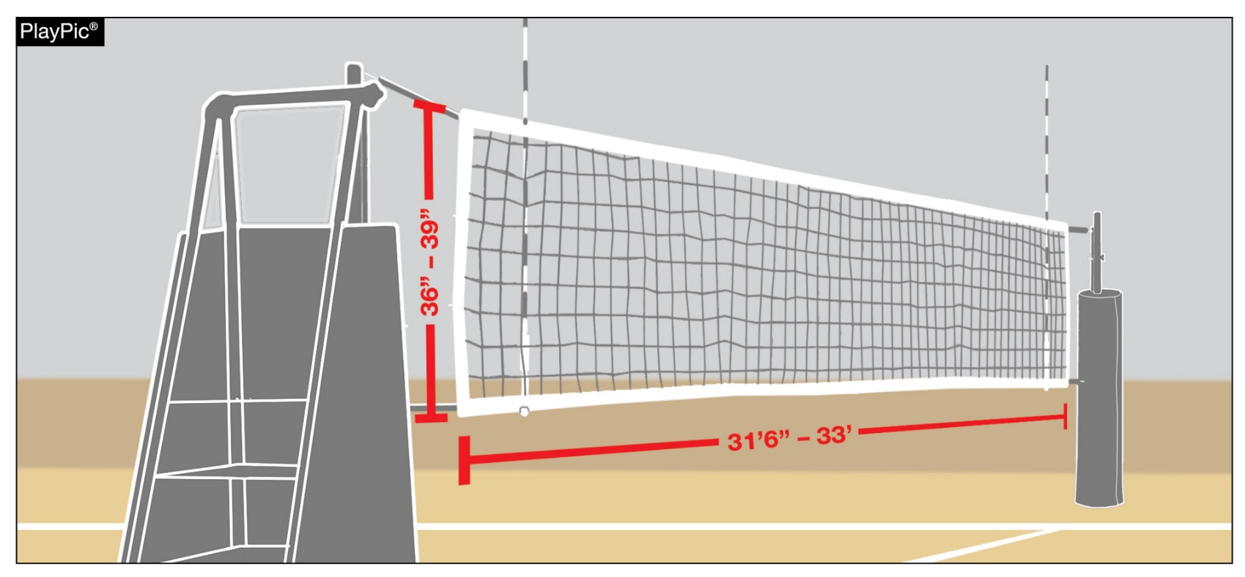
HOST MANAGEMENT BEST PRACTICES
Regularly evaluate volleyball equipment for signs of wear like frayed nets or cables, posts that are bending inwards, and padding that no longer protects or fits tightly — plus any parts that no longer hold proper tension. Any time you see a post or net that has been taped or improvised to keep it working, it is a sign the system is not performing — or protecting athletes and officials — the way it was designed to and should be replaced.
Notes:
Regularly evaluate volleyball equipment for signs of wear like frayed nets or cables, posts that are bending inwards, and padding that no longer protects or fits tightly — plus any parts that no longer hold proper tension. Any time you see a post or net that has been taped or improvised to keep it working, it is a sign the system is not performing — or protecting athletes and officials — the way it was designed to and should be replaced.

Slide 16
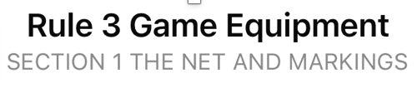
When the host school does not pad
the standards,
floor/wall cables
first referee's platform
according to Rule 3-1-3, the match shall not be played, and the state association shall be notified to determine further action or penalty, as deemed necessary.
Note: If just the platform is improperly padded, the referee may officiate the match from the floor.

Slide 17
Game Equipment
The standards, first referee's platform and floor/wall cables shall be padded as follows:
Standards shall be padded to a minimum height of 5½ feet with at least 1-inch-thick, resilient, shock-absorbing material (such as polyethylene foam) to encase the uprights and all tensioning devices;
Front and sides of first referee's platform shall be padded in the same manner as the standards;
Any guy cables or rigid braces shall be padded to a minimum height of 5½ feet with at least ½-inch-thick resilient, shock-absorbing material.

Slide 18
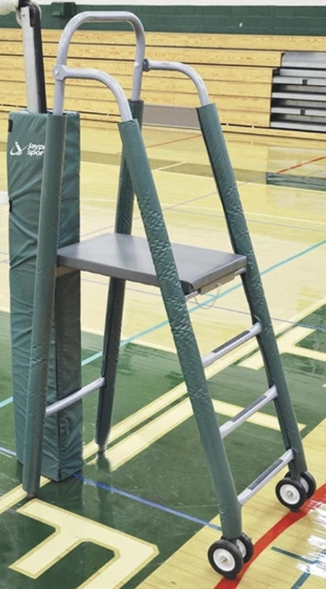
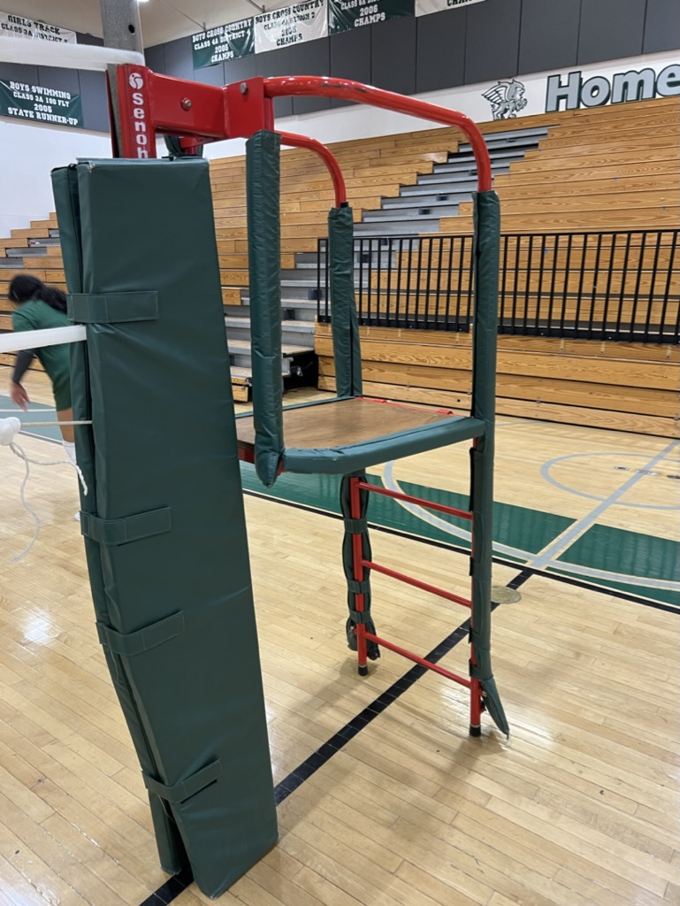
NFHS Pre-match Safety Responsibilities for Volleyball Officials
The first referee's stand must be properly padded but what are often overlooked with the new equipment padding are the wheels … These wheels are not covered and are in an area that a player can come into contact with and be injured.

Slide 19
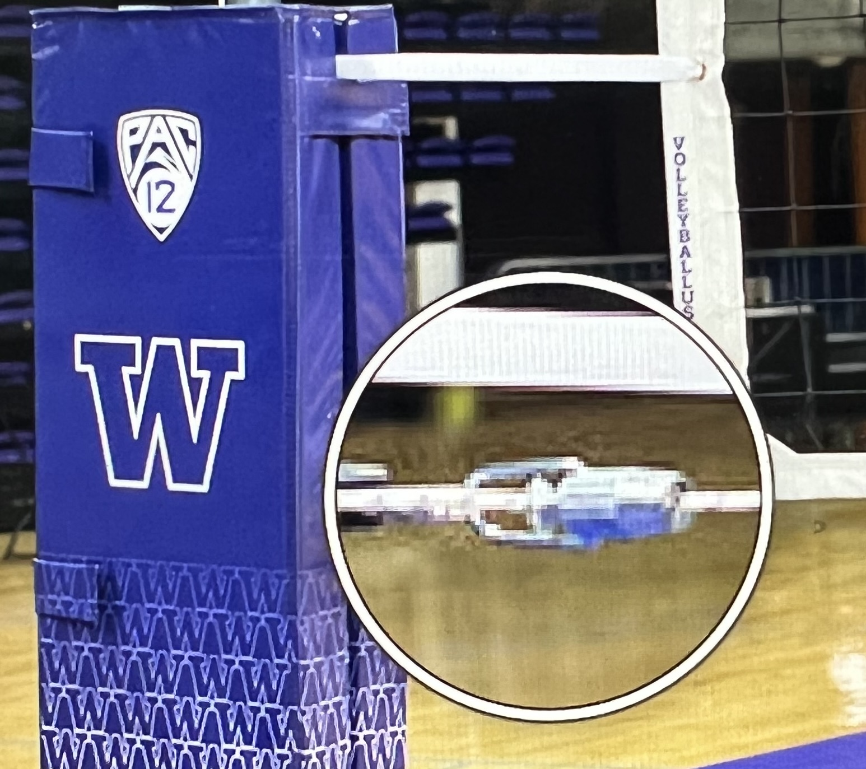
Any exposed steel cable and/or metal tensioning device through the
top and bottom
of the net shall be covered.
Pool Noodles are great for this

Slide 20
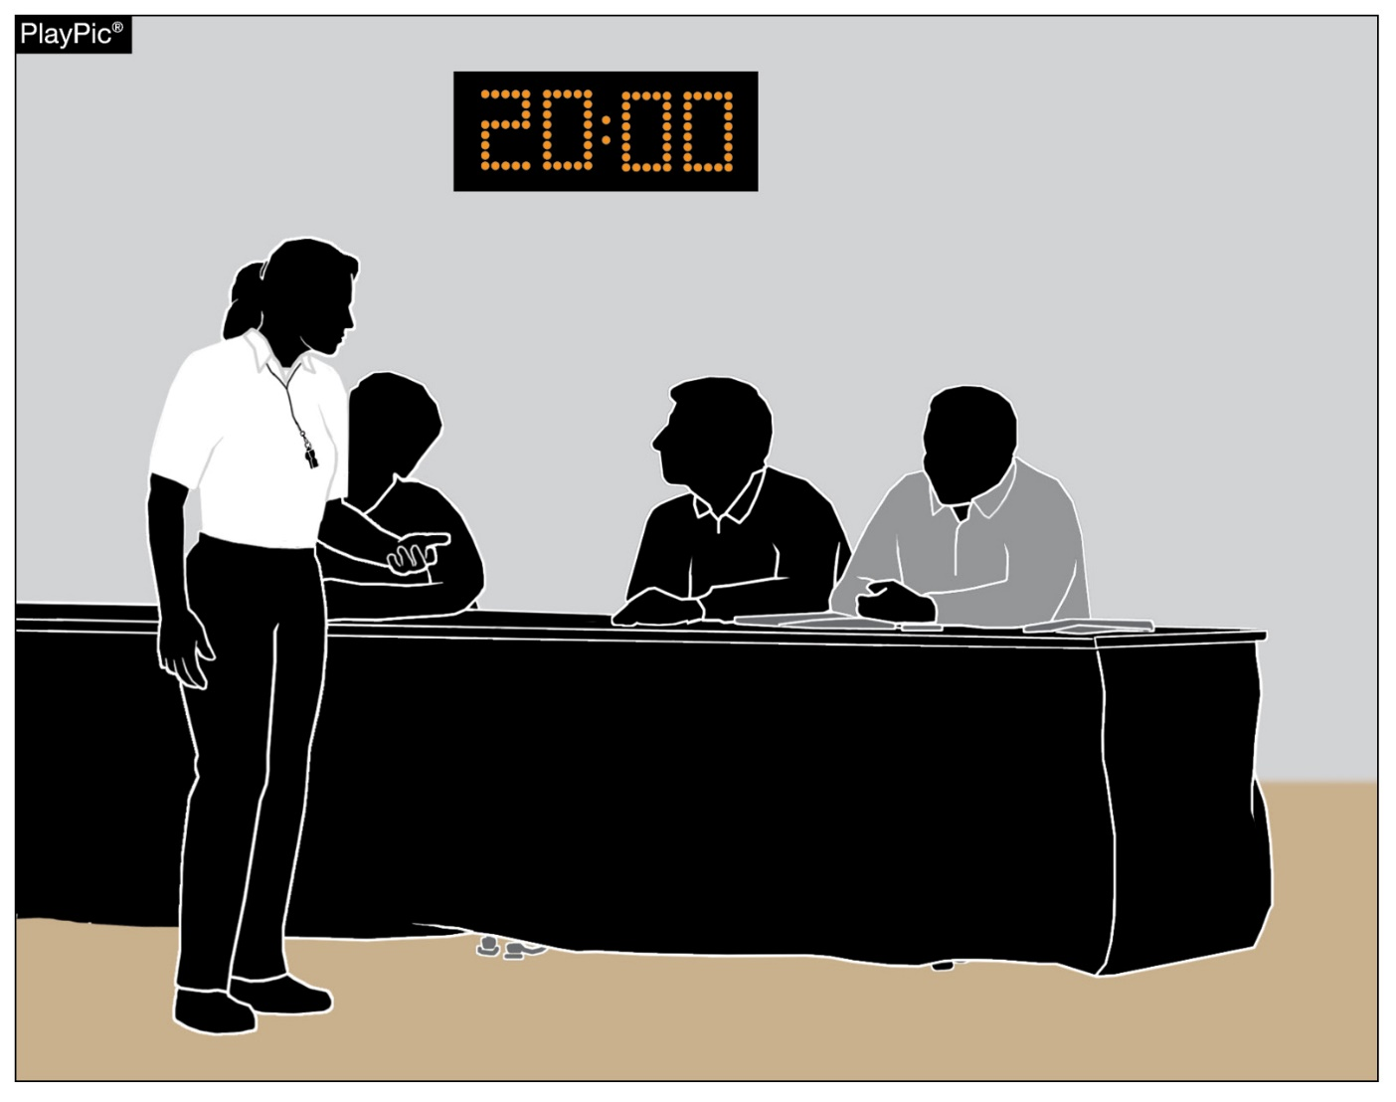
HOST MANAGEMENT BEST PRACTICES
To set the match up for success, it is imperative that assistant officials:
(scorer, libero tracker, timer and line judges)
are secured by host management and have reported to the first referee no less than 20 minutes prior to the starting time.
Notes:
To set the match up for success, it is imperative that assistant officials (scorer, libero tracker, timer and line judges) are secured by host management and have reported to the first referee no less than 20 minutes prior to the starting time.

Slide 21
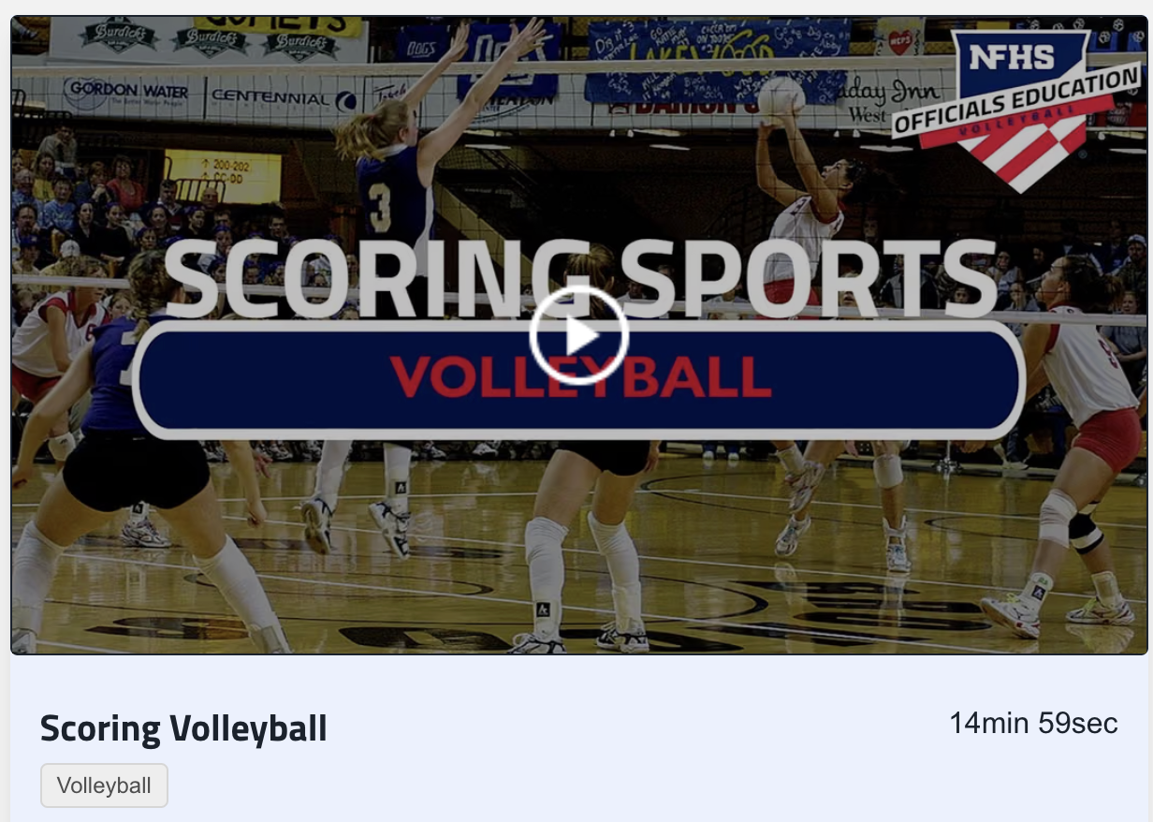
The NFHS provides videos you can use to train individuals how to keep score and libero track.
These videos can be accessed from the FHSAA Central Hub on Arbiter

Slide 22
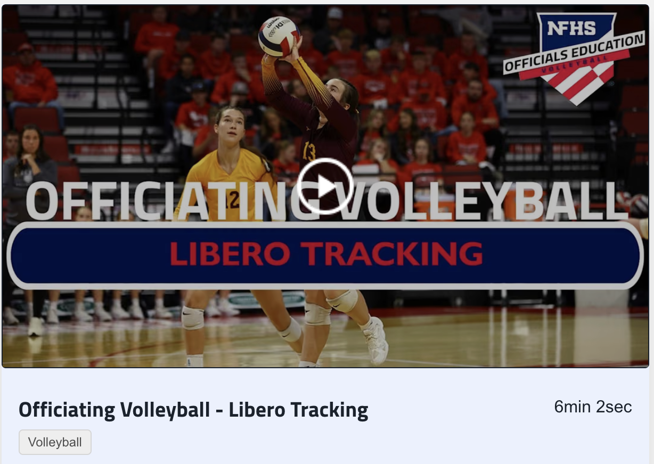
Links to these videos will also be posted on the HCVOA website:
www.HCVOA.com

Slide 23
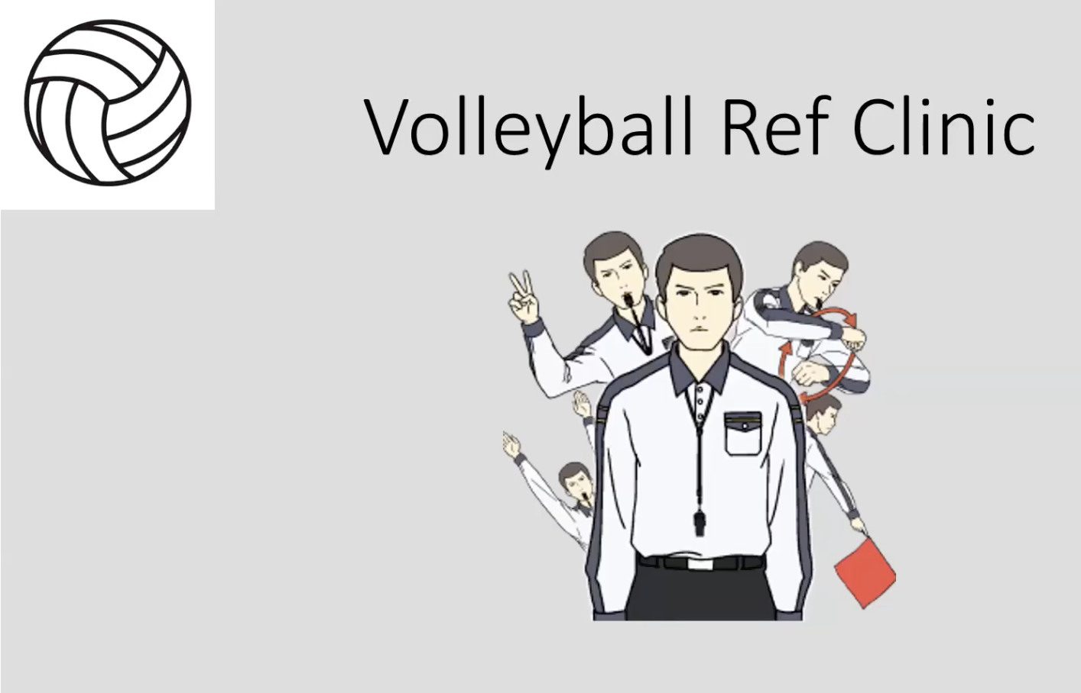
Copy and paste the link below to watch this 8 minute video on proper line judging
https://www.youtube.com/watch?v=UV1KtUuh-qw

Slide 24
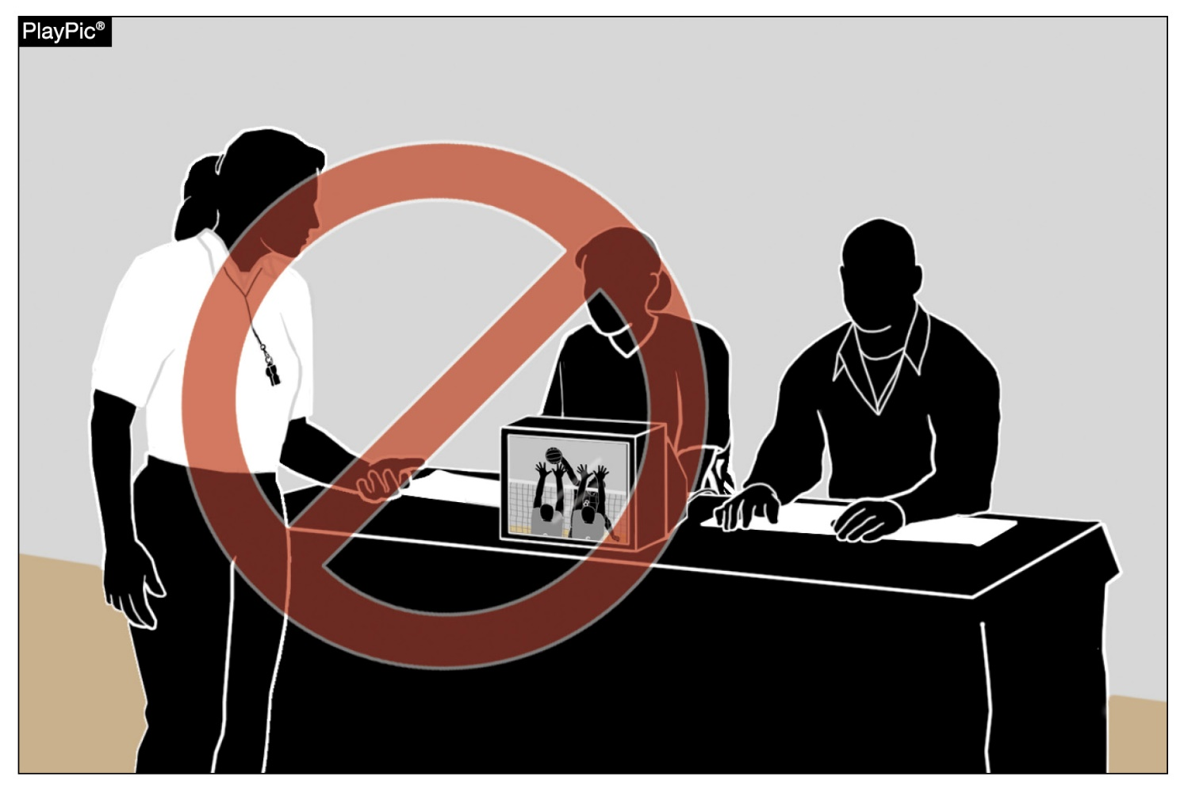
ELECTRONIC DEVICES
At no time during the match may an official use an electronic device to review a decision of the referee.
At no time shall the first or second referee consider replay.
Notes:
At no time during the match may an official use an electronic device to review a decision of the referee.
At no time shall the first or second referee consider replay.

Slide 25
Electronic Devices
A team may use electronic devices during the match as long as they are not in restricted areas as determined by the host and as long as the first referee determines that they are not interfering with the contest.
Referees are permitted to wear headsets for communication purposes. Officiating Volleyball: Using Wireless Communication
State associations may have policies to further address the allowance and/or restriction of electronic device use during matches.
Notes:
A team may use electronic devices during the match as long as they are not in restricted areas as determined by the host and as long as the first referee determines that they are not interfering with the contest.
Referees are permitted to wear headsets for communication purposes. Officiating Volleyball: Using Wireless Communication
State associations may have policies to further address the allowance and/or restriction of electronic device use during matches.

Slide 26

BENCH PERSONNEL – NON-PLAYING TEAMMATES
Non-playing teammates (bench players) and other bench personnel have a role to positively support their teammates by celebrating and encouraging those playing on the court with spontaneous cheers.
It is not legal for anyone on the bench to use props.
A towel is athletic equipment and is not considered a prop if used in conjunction with a spontaneous celebration.
Notes:
Non-playing teammates (bench players) and other bench personnel have a role to positively support their teammates by celebrating and encouraging those playing on the court with spontaneous cheers.
It is not legal for anyone on the bench to use props.
A towel is athletic equipment and is not considered a prop if used in conjunction with a spontaneous celebration.

Slide 27
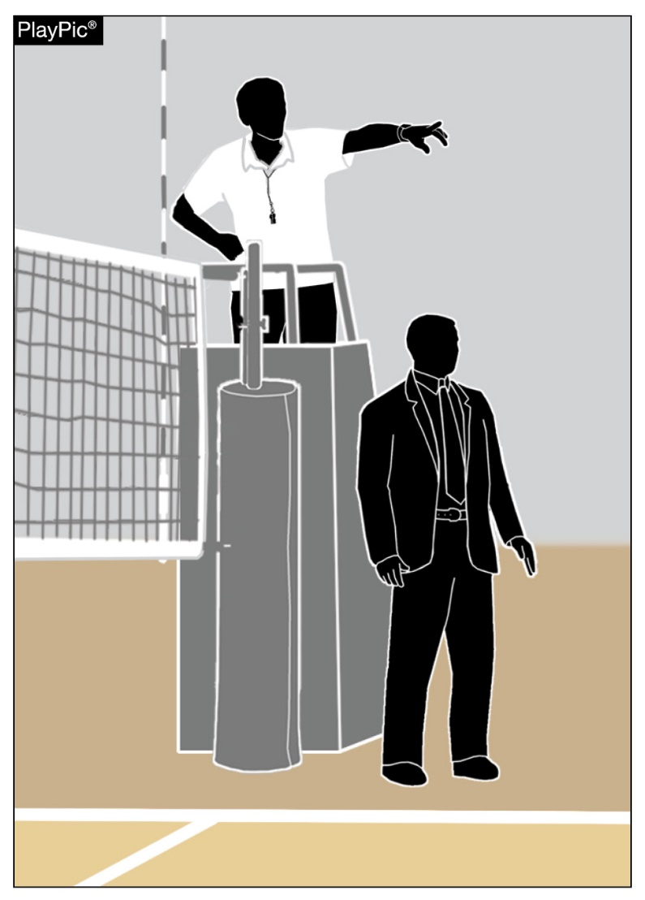
BENCH PERSONNEL – NON-PLAYING TEAMMATES
Game officials shall not address spectators at any time;
however, referees have the responsibility to notify game management of any spectator misconduct.
Unsporting conduct by spectators is the responsibility of the host management. In the absence of host management, the responsibility for addressing spectator behavior shall revert to the host head coach.
Notes:
Game officials shall not address spectators at any time; however, referees have the responsibility to notify game management of any spectator misconduct.
Unsporting conduct by spectators is the responsibility of the host management. In the absence of host management, the responsibility for addressing spectator behavior shall revert to the host head coach.

Slide 28
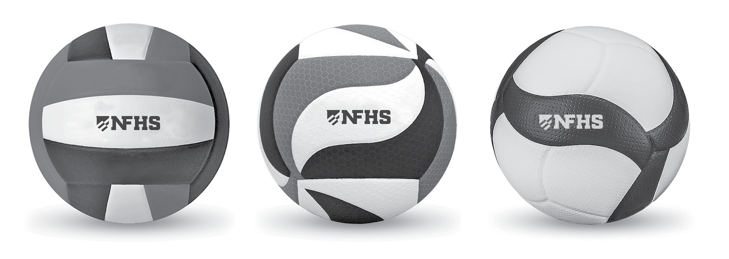
IDENTIFICATION OF THE NFHS AUTHENTICATING MARK ON GAME BALLS
All game balls are required to display the NFHS Authenticating Mark.
Game officials must remain vigilant and report any non-compliant game balls to the state association office.
Notes:
All game balls are required to display the NFHS Authenticating Mark.
Game officials must remain vigilant and report any non-compliant game balls to the state association office.

Slide 29
Player Equipment
All students on the court must be legally and properly equipped at all times. This includes:
  Line Judges
  Ball Shaggers
  Team Managers
Properly Equipped includes:
  Gym Shoes (No Crocs, slides, sandals, etc.)
  No Jewelry except small studs, above the neck.

Slide 30
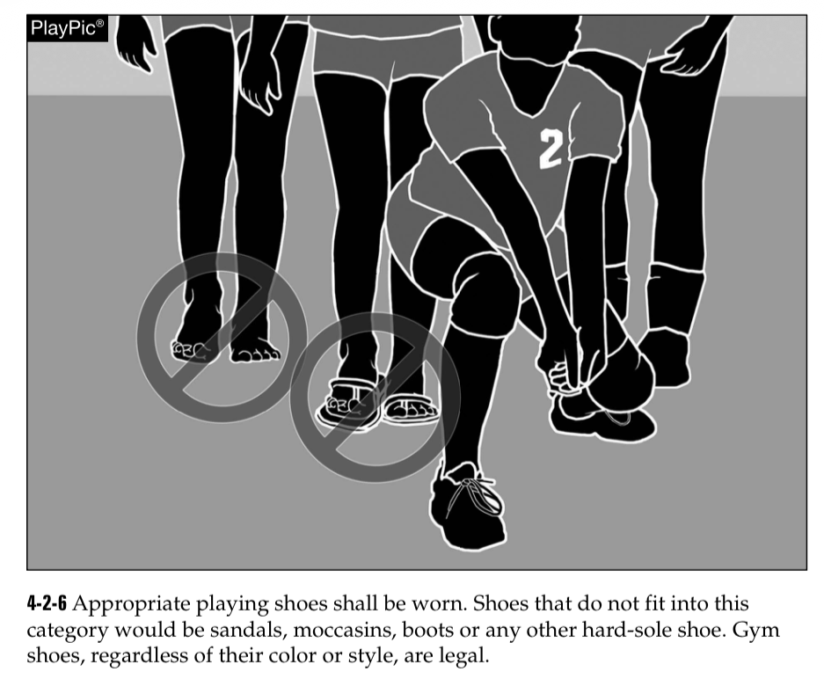
All players or students must be legally and properly equipped when on the court.
This includes wearing proper gym shoes, legal jewelry, and no headphones and airpods.

Slide 31
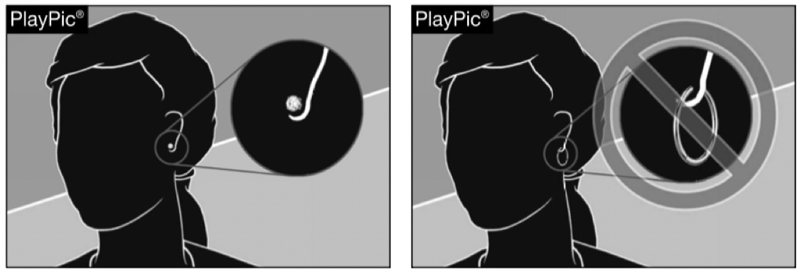
4-1-7, 4-1 PENALTY 1
All jewelry shall be removed,
except small, secured jewelry (stud or post).
No jewelry shall be permitted below the chin.
String bracelets, commemorative bracelets and body jewelry are considered jewelry and are not permitted.
Taping over jewelry is not permitted.

Slide 32
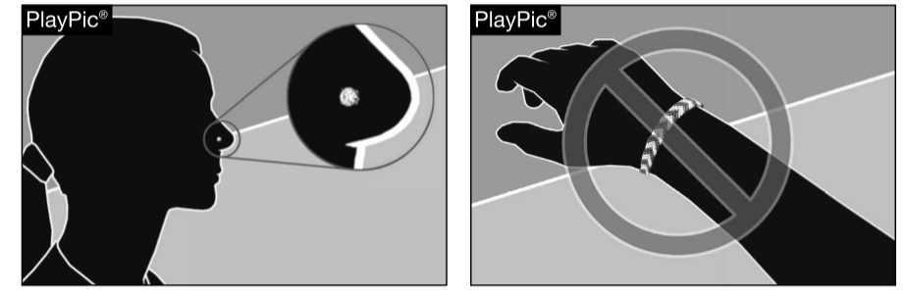
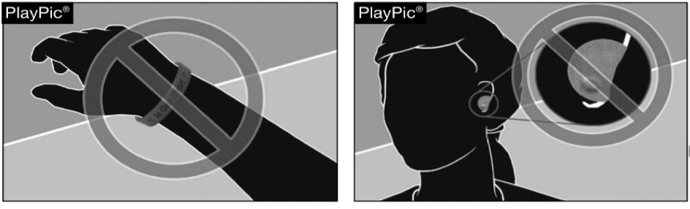

Slide 33

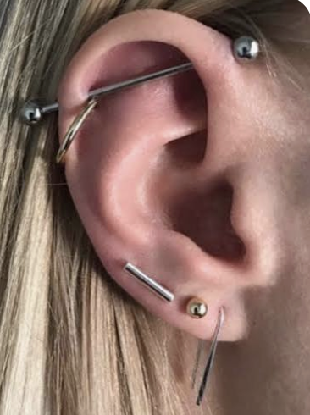
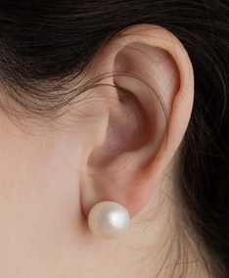

The only legal jewelry in any of these pictures is the small stud earring in the picture on the bottom left.

Slide 34
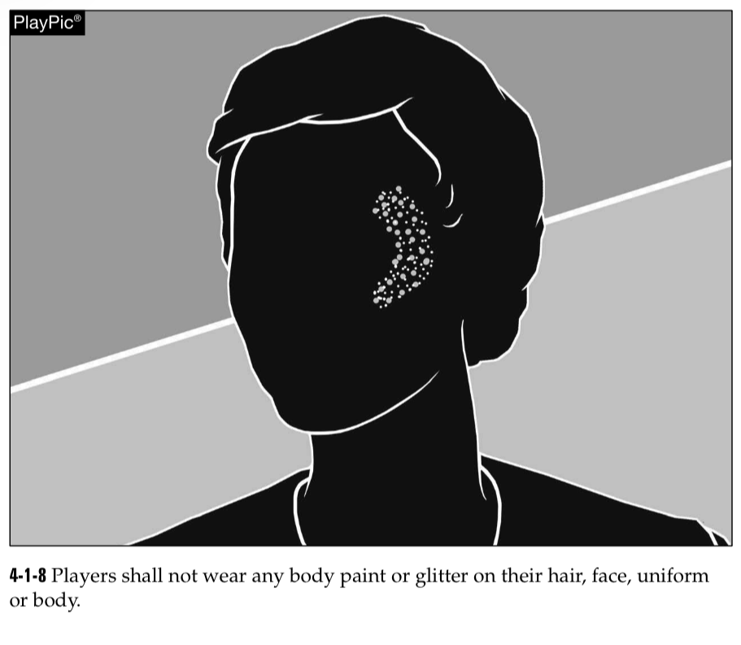
Players shall not wear body paint or glitter on their
Hair
Face
Uniform
Body

Slide 35
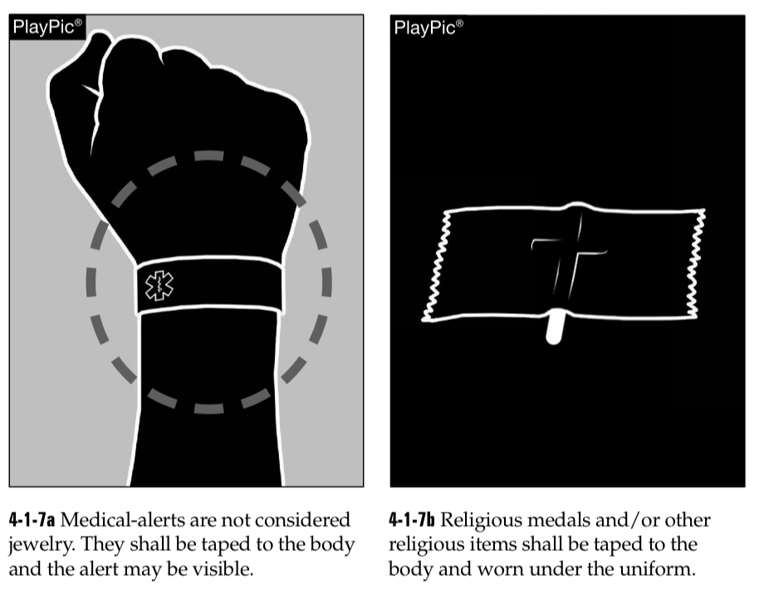
While Players are allowed to wear medical ID’s and religious jewelry, they are never allowed to wear a chain around their neck.

Slide 36
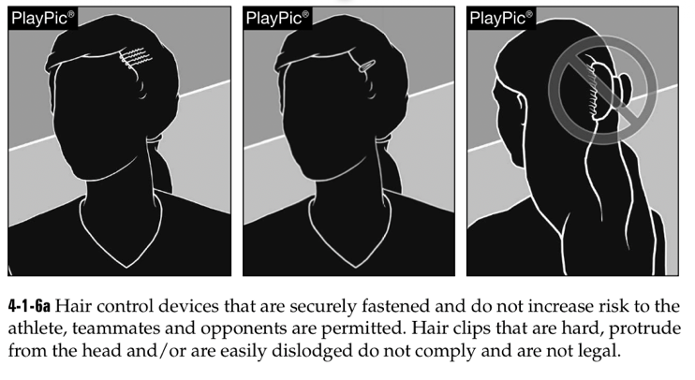
https://zoom.us/rec/play/VedVvXEIIwMr8ajYvRdLlywFtpcq5VdhQoyQRAvmaKYWMXl1ThNByH-fojxFw4cz8SXgbap61sE0aKhU.0cGYhwHuCXNJKs1R?autoplay=true&startTime=1785883338000

Slide 37
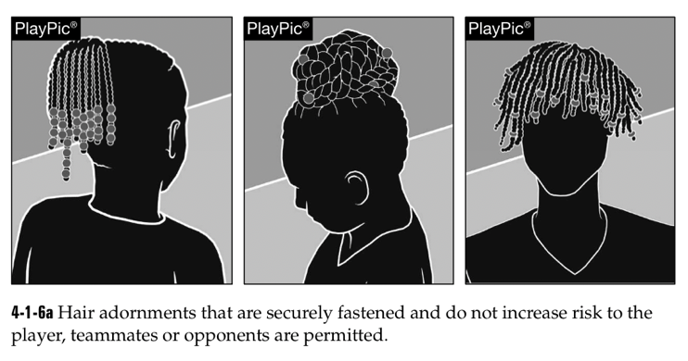

Slide 38
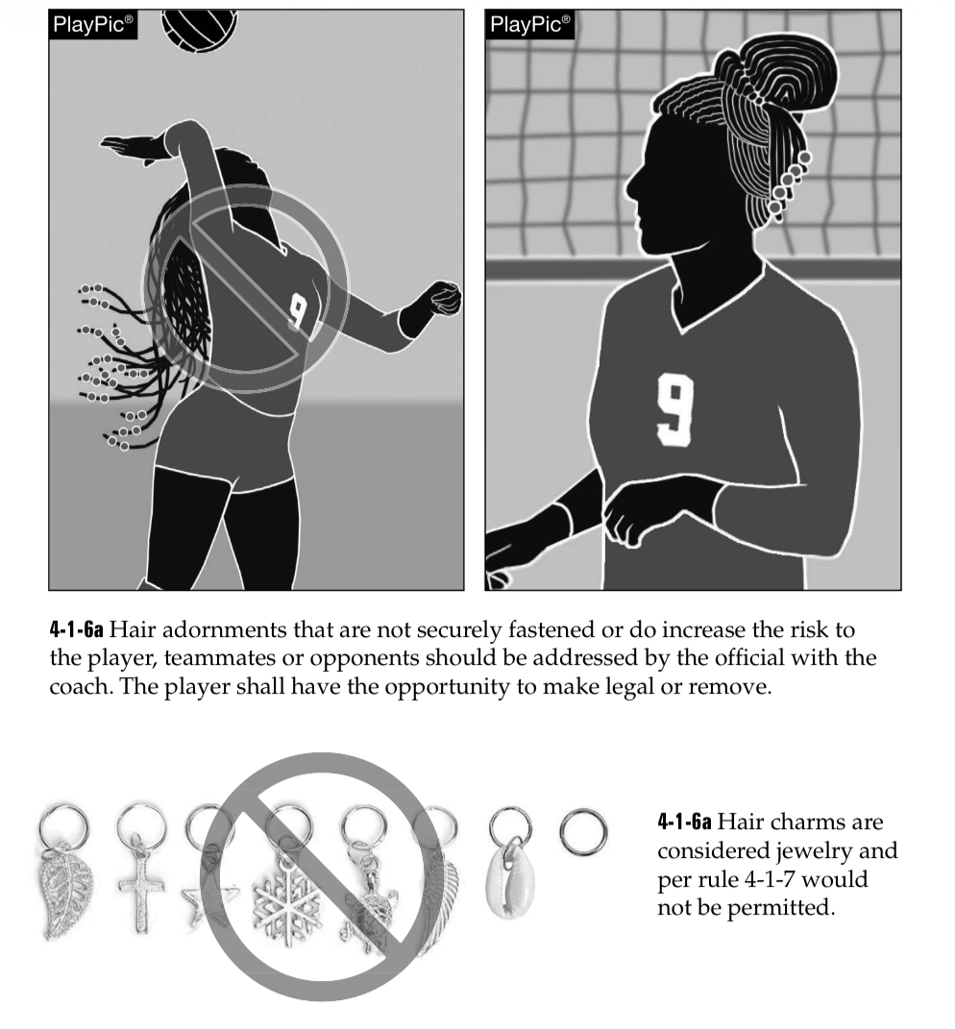

Slide 39
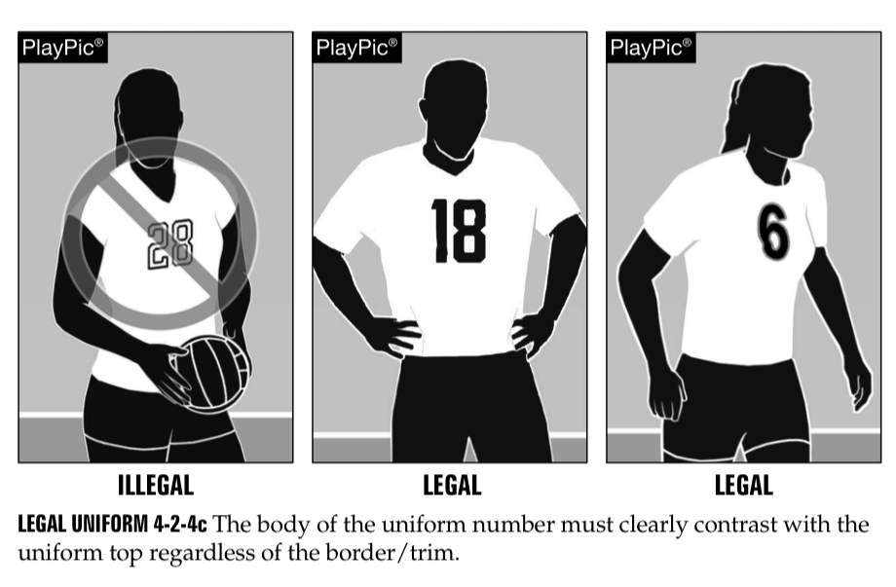

Slide 40
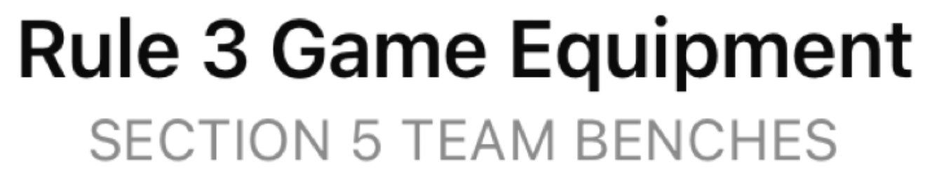
Team benches shall be:
On the same side of the court as the officials' table,
Placed no closer to the sideline than 6 feet
No closer to the out-of-bounds extension of the center line than 10 feet.

Slide 41
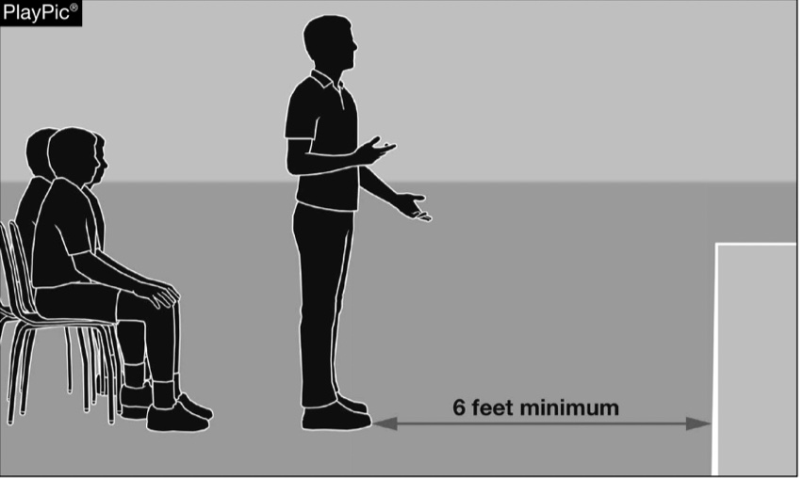
12-2-5 The head coach may stand in the coaching zone, defined as the libero replacement zone and the area beyond the end line and sideline extended to coach. During play, the head coach shall be no closer to the court than six feet from the sideline.

Slide 42
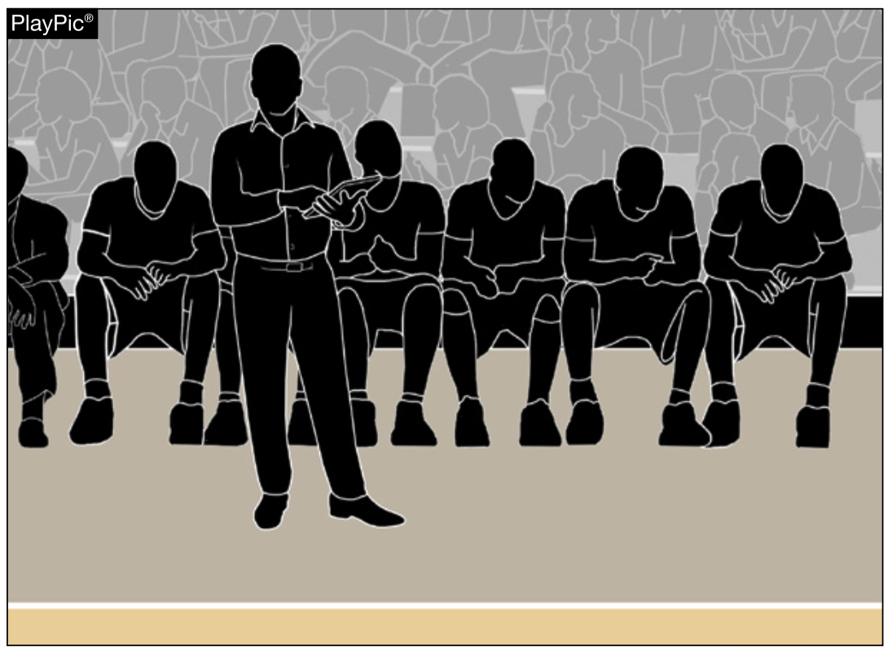
There needs to be a minimum of 7 to 8 feet between the sideline and the bench in order to give the coach room to stand

Slide 43
Scorer’s Table
The only people allowed to be at the scorer’s table are the:
    Clock Operator
    Official Scorer(s)
    Libero Tracker
  The scorer’s table should be at least 8 feet away from the sideline

Slide 44
Scorer’s Table
The NFHS has produced new scoresheets and libero tracking sheets due to the new rules allowing for up to 2 liberos in a game,
These sheets are available on the FHSAA Central Hub under the volleyball tab
https://www1.arbitersports.com/front/103524/Site/Sports/Volleyball

Slide 46
Miscellaneous

Slide 47
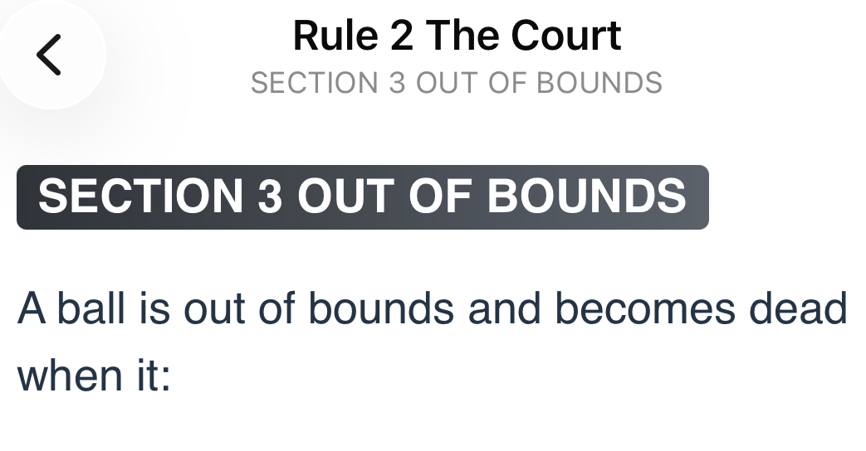

Slide 48
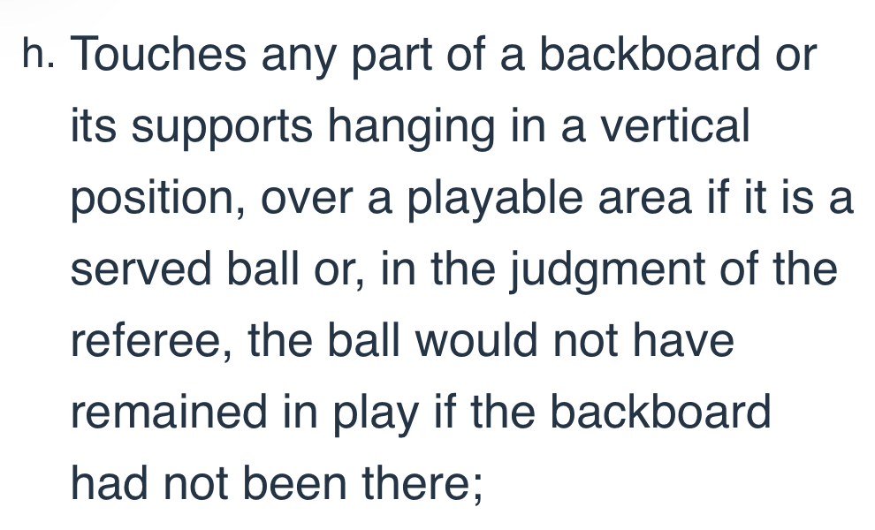

Slide 49
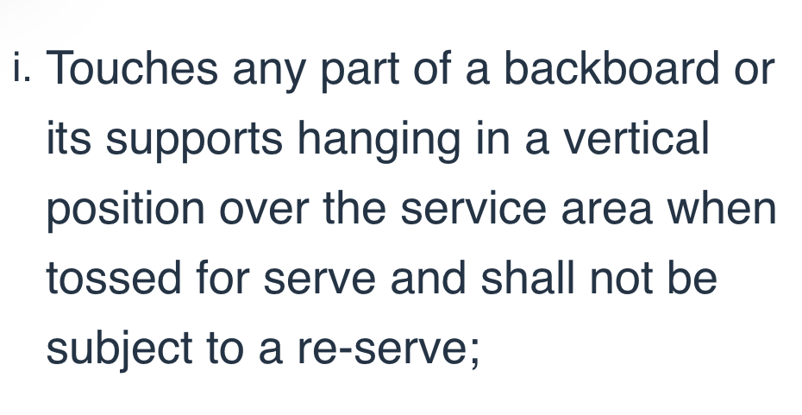

Slide 50
Rule 6 The Team: Composition and Positions
SECTION 3 THE CAPTAIN
ART. 2 ... During any dead ball, the playing captain may request the following for the captain's own team:
  Time-out;
  Verification of time-outs used;
  Verification of serving order. The playing captain may request verification of the proper server for the opponent, and, if a signal is missed, ask the first referee to repeat the call.

Slide 51
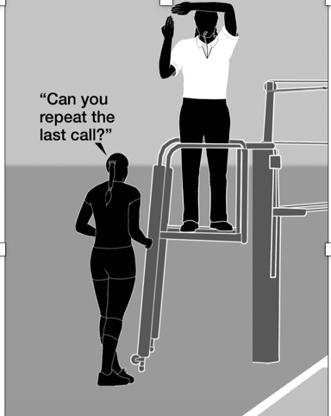
Team captains are not allowed to come over to the referee stand to discuss or disputes calls with the R1.

Slide 52
Rule 11 Time-outs and Intermission
SECTION 3 REVIEWING DECISIONS
ART. 3 ... Decisions based on the judgment of the referee(s) are:
Final and not subject to review

Slide 53

ART. 1 ... To review a decision by a referee that may have resulted in an incorrect decision,
The head coach may request and be granted a time-out, provided the request is made during the dead ball immediately following the situation in which the possible incorrect decision occurred.

Slide 54
When a time-out is so granted, the head coach shall confer with the first referee at the first referee's platform.
If the conference results in the first referee altering the ruling, the opposing coach shall be notified by the second referee, the revision made, and the time-out charged to the referee

Slide 55
ART. 8 ... Unsporting conduct for a coach, non-playing teammate or team attendant includes, but is not limited to the following:
Using disconcerting acts or words when an opponent is about to play the ball
This includes any player or bench personnel making any sound(s) to distract a server

Slide 56
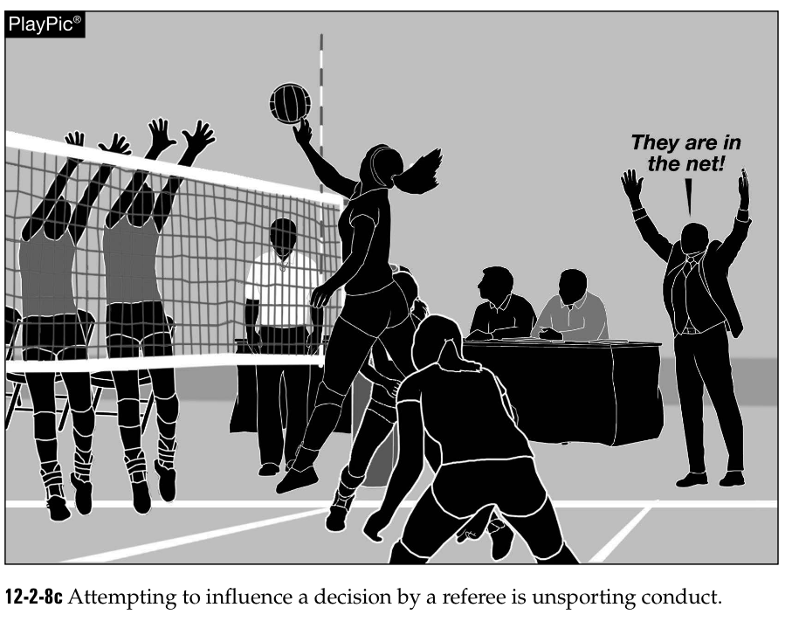
Rule 12-2-8c Attempting to influence a decision by a referee is unsporting conduct.

Slide 57
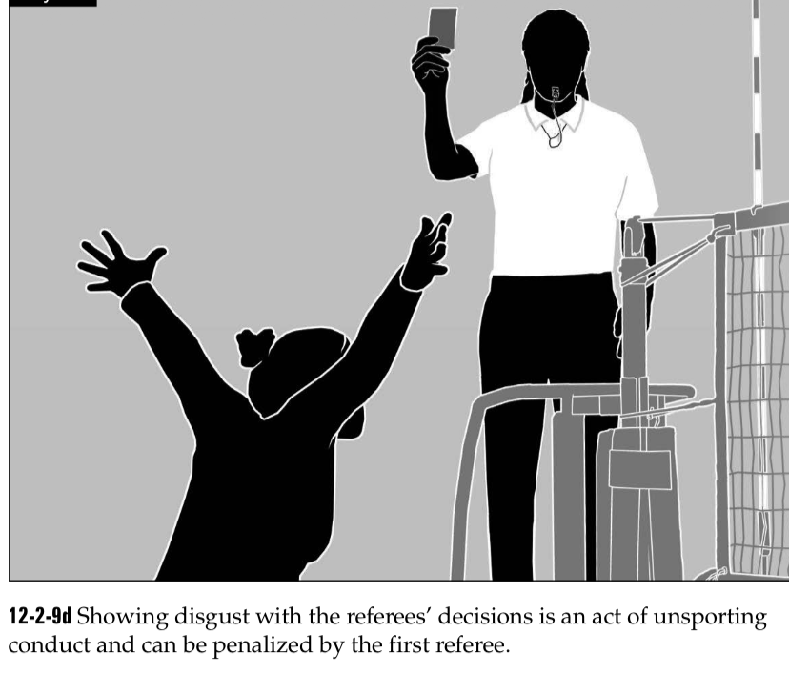
Rule 12-2-9d
Showing disgust with the referees' decisions is an act of unsporting
conduct and can be penalized by the first referee.

Slide 58
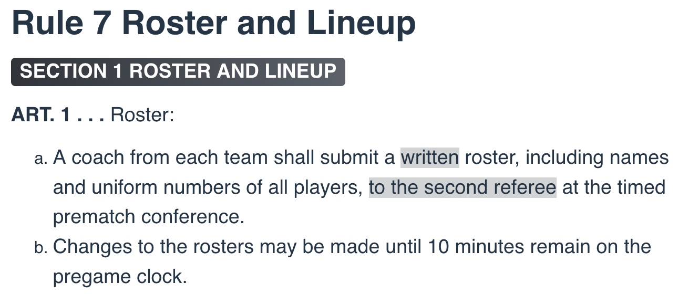

Slide 59
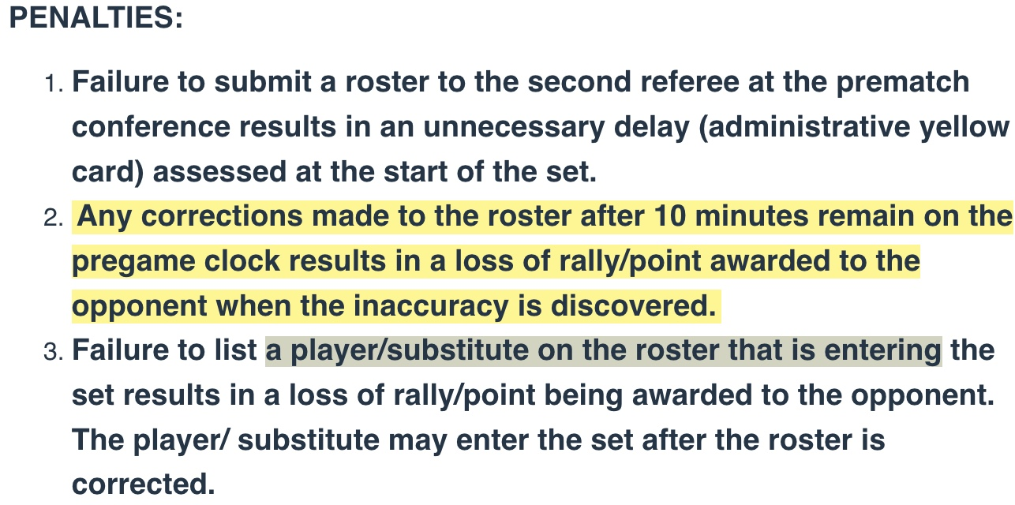

Slide 60
Questions?

Slide 61
Thank You
NFHS.org Phone # 317-972-6900 Email: latkinson@nfhs.org

